Slide 1
UBER RIDES
Supply-Demand Gap Analysis
Excel · SQL · Python EDA | Jul 11–15, 2016 | 6,745 Ride Records
6,745
41.97%
58.03%
3 Tools
Total Rides
Completion Rate
Failure Rate
Analysis Stack
Data Analytics Project · 2016 Uber Dataset

Slide 2
Project Introduction
Context & motivation behind the analysis
Project Overview
Key Objectives
This project conducts an Exploratory Data Analysis (EDA) on Uber request data to understand various aspects of ride-hailing operations. The goal is to identify patterns, insights, and potential areas for improvement in service efficiency and user experience. • Excel: Data cleaning, KPI metrics, and an interactive dashboard for visual exploration. • SQL (DuckDB): Advanced query-based analysis to uncover supply gaps, failure patterns, and hourly demand cycles. • Python EDA: Statistical exploration and visualizations using pandas, matplotlib & seaborn to identify patterns and potential areas for improvement in service availability.
1
Understand the overall distribution of trip outcomes
2
Identify supply-demand gaps by location and time
3
Analyse 24-hour demand cycles and peak failure windows
4
Compare Airport vs City pickup performance
5
Detect critical failure zones exceeding 65% failure rate
6
Provide data-driven business recommendations

Slide 3
Problem Statement
What challenge is this project solving?
Unmet Demand
Location Blind Spots
58% of all Uber ride requests in this dataset fail — either no car is available (39.3%) or riders cancel (18.7%). Over 3,900 trips go unfulfilled.
Airport pickups have a 52.9% No-Car rate — more than double the City's 26.7%. The supply crisis is geographically concentrated, not random.
Time-Based Failure
Declining Performance
Evening hours (17–21h) at Airport suffer 55–76% no-car rates, creating a predictable, recurring 5-hour supply blackout affecting ~1,400 daily requests.
Over the 5-day window, completion rate erodes from 44% to 40.6% — a 3.4-point drop. If the trend holds, rates fall below 35% within two weeks.

Slide 4
Proposed Solution & Tools
Analytical approach and technology stack
Microsoft Excel
SQL — DuckDB
Python EDA
Data Cleaning & Dashboard
Deep Query Analysis
Statistical Exploration
✓ Removed duplicates & handled nulls
✓ 8 structured analytical queries
✓ Data loading & preprocessing
✓ Extracted hour/date from timestamps
✓ Status distribution & location breakdown
✓ Univariate & bivariate analysis
✓ Built pivot tables & KPI cards
✓ Hourly demand cycle analysis
✓ Heatmaps, box plots & distribution charts
✓ Created interactive visual dashboard
✓ Critical failure zone identification
✓ Pattern discovery & correlation analysis

Slide 5
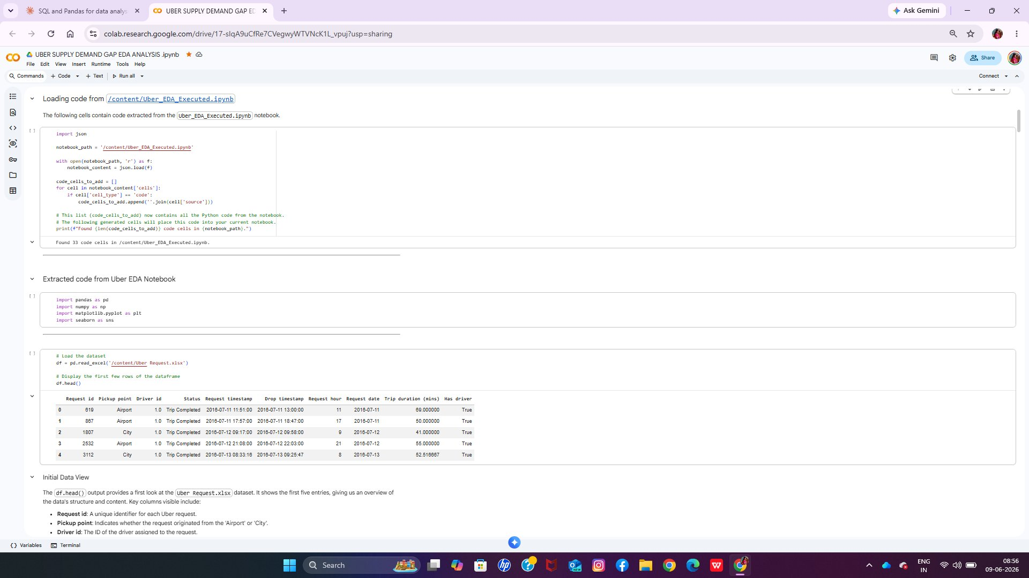
Dataset Description
Uber Ride Request Data — Jul 11–15, 2016
6,745
7
Raw Dataset Preview
Total Records
Columns
5 Days
2 Locations
Date Range
Airport & City
Dataset Columns
Request ID · Request Timestamp
Pickup Point (Airport / City)
Driver ID · Status
Drop Timestamp · Trip Duration (mins)
Screenshot: Uber_Request_Data.xlsx — raw unprocessed data

Slide 6
01
Excel Analysis
Data cleaning · KPI metrics · Interactive dashboard

Slide 7
Excel Analysis — Implementation
Steps carried out on the Uber dataset in Excel
1
Data Cleaning
2
KPI Summary Cards
Removed duplicate records, handled missing Driver IDs, standardised timestamp format and extracted hour/date fields for time-based analysis.
Computed headline metrics: Total Requests (6,745), Completed Trips (2,831), Cancellations (1,264), No-Cars (2,650), Avg Duration (52.4 min).
3
Pivot Tables
4
Visual Dashboard
Built pivots for status distribution by location, hourly volume, daily trends, and time-slot vs pickup completion rates.
Created a 6-chart interactive dashboard with bar charts, pie chart, line chart, time-slot heatmap, and hourly supply-gap comparison.

Slide 8
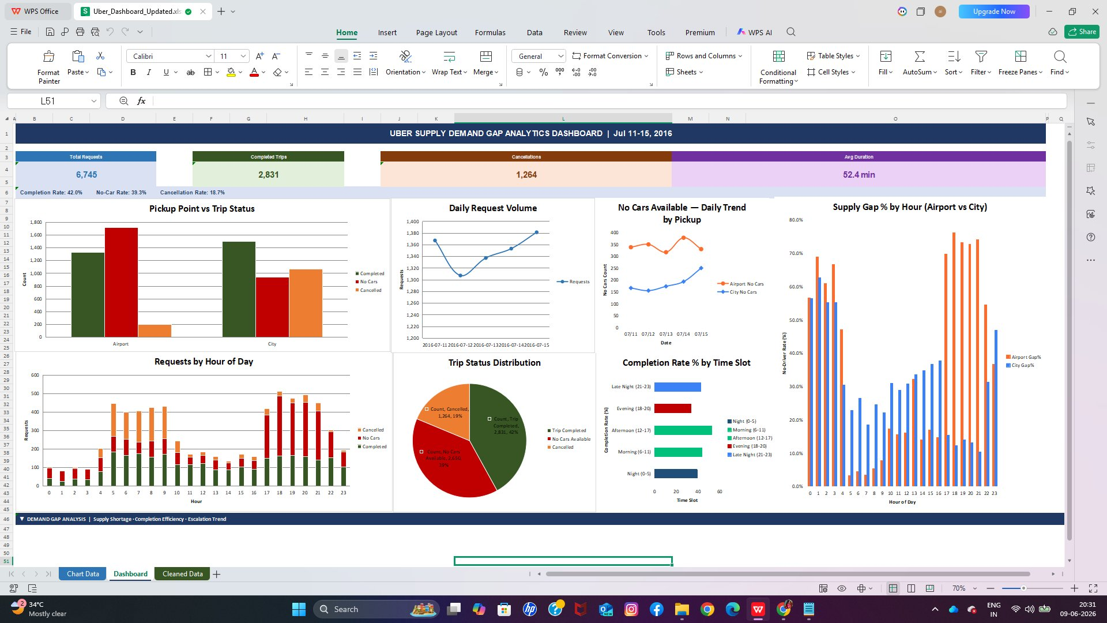
Excel Dashboard — Insights
Uber Supply Demand Gap Analytics Dashboard | Jul 11–15, 2016
Key Dashboard Insights
Only 42% of 6,745 rides complete — 58% fail from supply or cancellation issues
Airport No-Car rate peaks at 73–76% during Evening (17–20h) — a structural supply crisis
City cancellation rate is 5× higher than Airport — route/pricing friction dominates
Airport Morning (6–11h) leads with 84.4% completion — the operational gold standard
No-car failures are escalating day-over-day: 504 on Jul 11 → 580 on Jul 15 (+15.1%)

Slide 9
02
SQL Analysis
8 analytical queries · DuckDB engine · 6,745 records

Slide 10
SQL Analysis — Implementation
8 DuckDB queries analysing ride outcomes, demand cycles, and failure patterns
Q1
Overall Trip Status Distribution
Q2
Demand & Outcome by Pickup Location
Baseline health metrics — how 6,745 requests resolve across three outcome categories
Airport vs City — volume, completion rate, and failure mode comparison
Q3
24-Hour Demand Cycle by Status
Q4
Time-Slot × Pickup Point Matrix
Hourly rhythm to identify peak demand, cancellation spikes, and no-car surges
Cross-dimensional analysis of where and when service quality diverges most sharply
Q5
Top 12 Supply Gap Slots
Q6
Daily Volume & Outcome Trend
Driver shortage map ranking worst hour–location combinations by no-driver rate
5-day temporal drift — are conditions improving or deteriorating day over day?
Q7
Trip Duration Statistics by Location
Q8
Critical Failure Zones (>65%)
Full distribution stats (avg, min, max, std dev, percentiles) on completed journey times
CTE-based triage isolating every hour–location slot where combined failure rate exceeds 65%

Slide 11
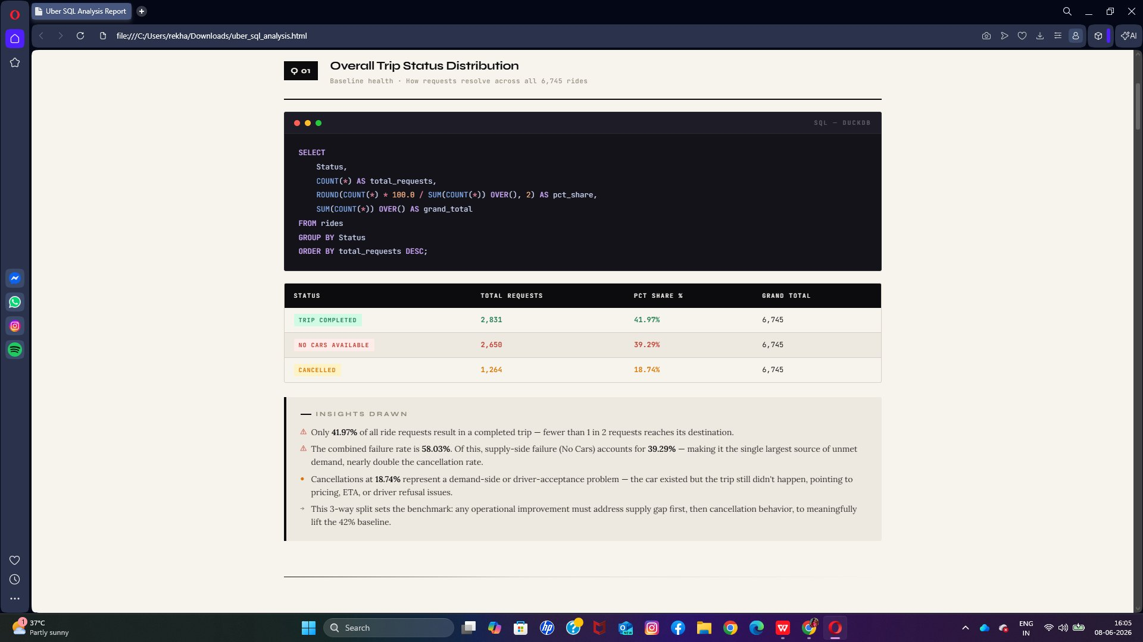
SQL Insight 01
Overall Trip Status — Only 42% Complete
Q1 · Overall Trip Status Distribution
Insights Drawn
Only 1 in 2 ride requests reaches its destination — a systemic failure, not an occasional glitch
No Cars Available (39.3%) is the single largest failure mode — nearly double the cancellation rate
The combined 58% failure rate sets the benchmark: supply gap must be solved first to meaningfully lift completion
📊 Trip Completed: 2,831 (41.97%) · No Cars Available: 2,650 (39.29%) · Cancelled: 1,264 (18.74%)

Slide 12
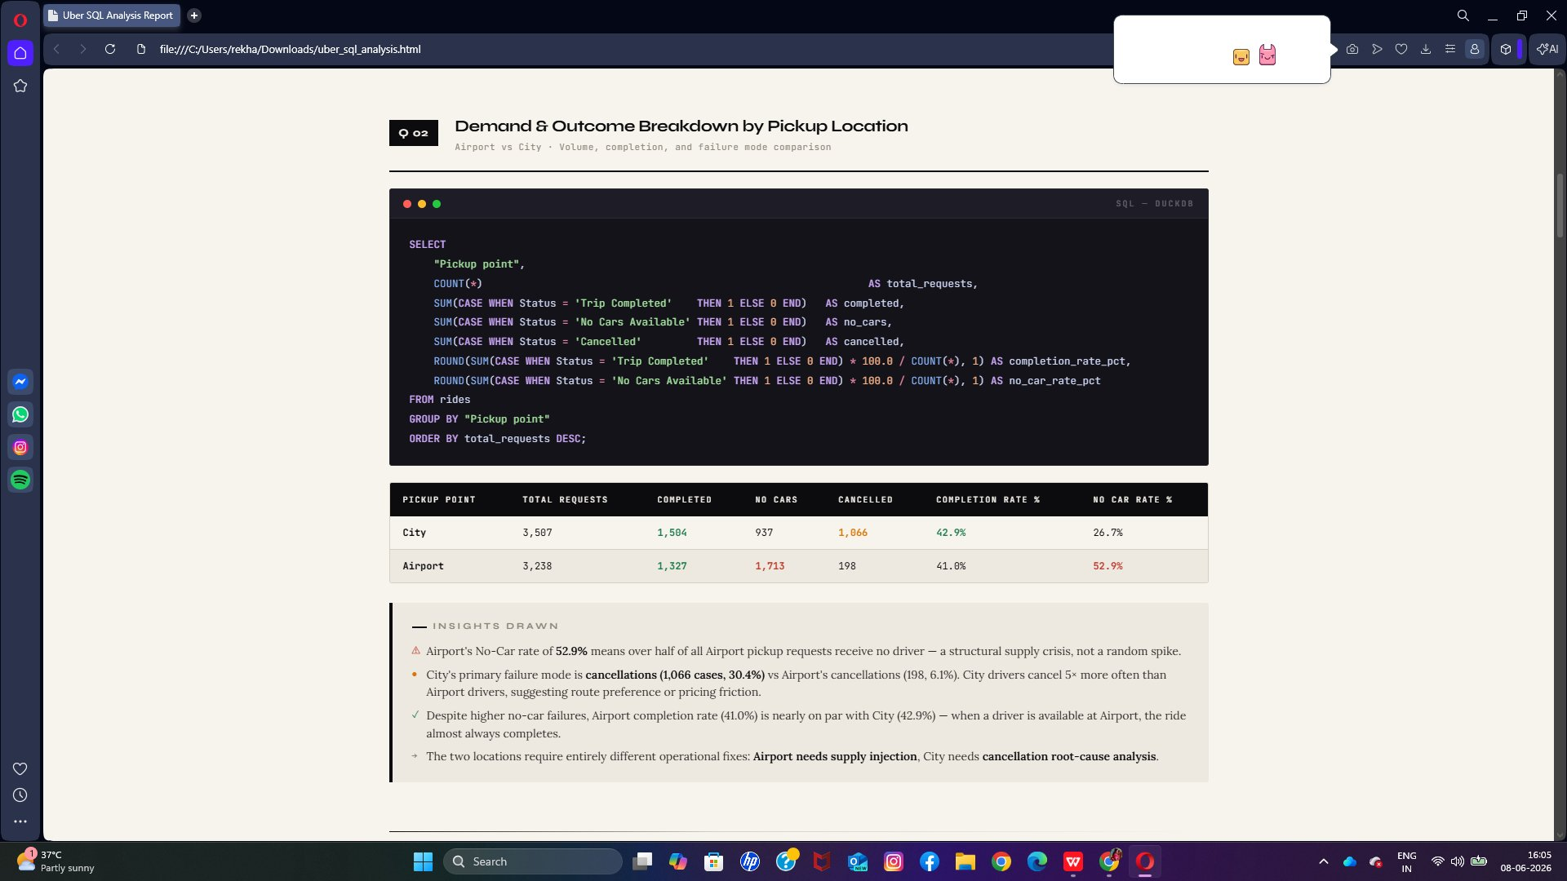
SQL Insight 02
Airport vs City — Diverging Failure Modes
Q2 · Demand & Outcome Breakdown by Pickup Location
Insights Drawn
Airport's 52.9% No-Car rate means over half of all Airport pickup requests receive no driver — a structural supply crisis
City's cancellation count (1,066) is 5× higher than Airport's (198) — drivers arrive but reject rides
Each location requires a different fix: Airport needs supply injection; City needs cancellation root-cause analysis
📊 Airport: 3,238 requests | 52.9% No-Car rate | 41% completion · City: 3,507 requests | 26.7% No-Car | 1,066 cancellations

Slide 13
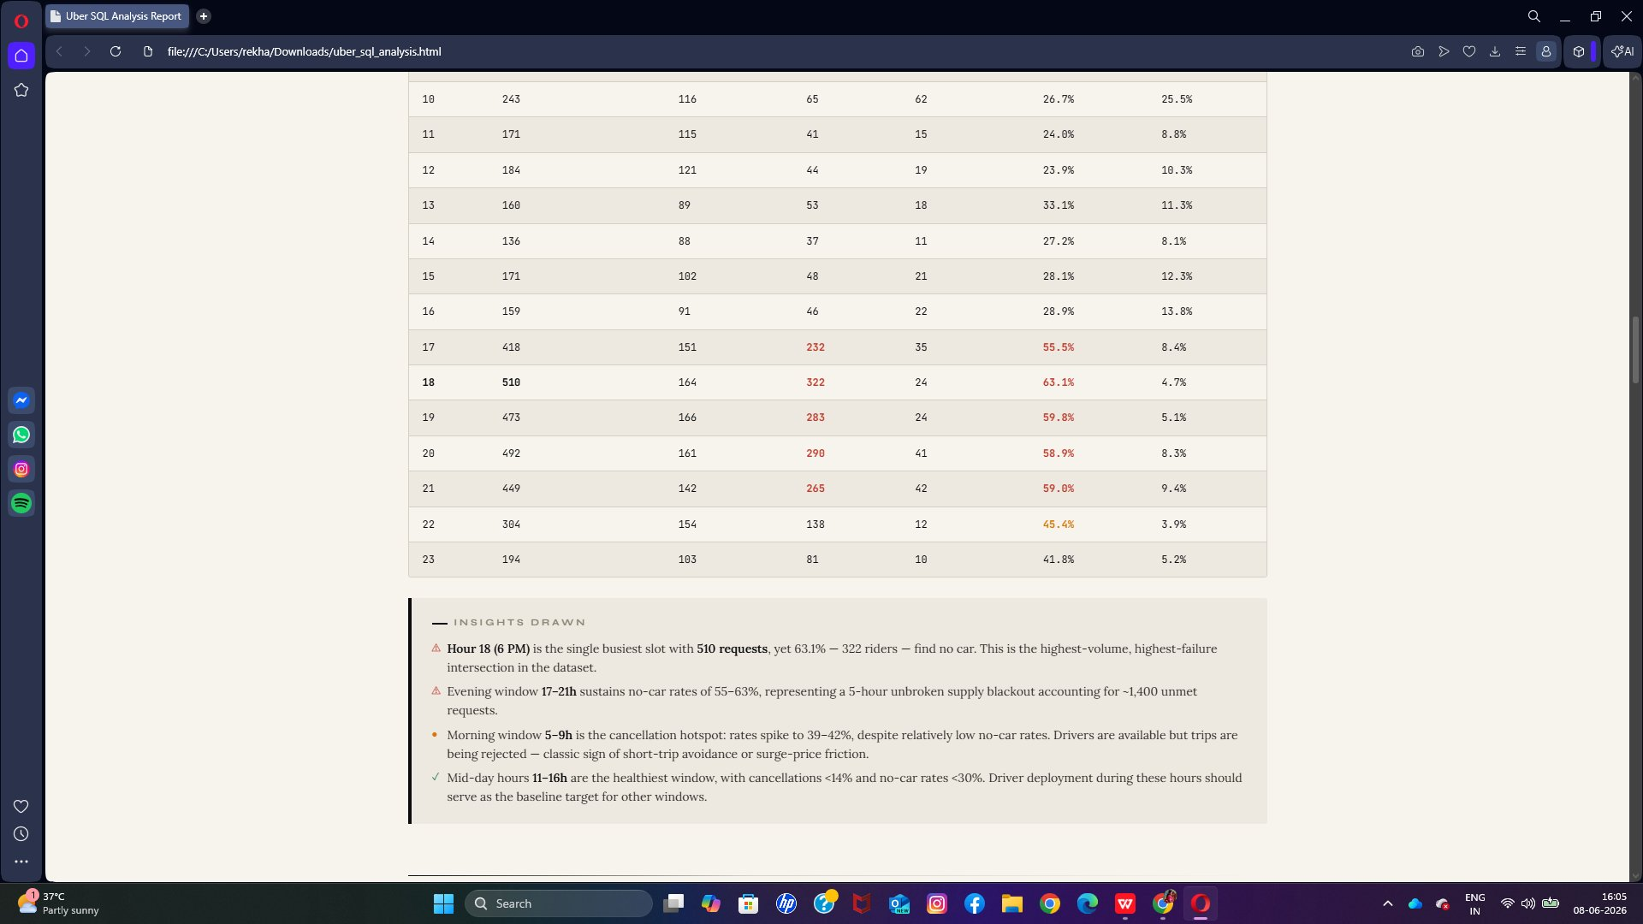
SQL Insight 03
24-Hour Demand — Evening Supply Blackout
Q3 · 24-Hour Demand Cycle by Status
Insights Drawn
Hour 18 (6 PM) is the highest-volume, highest-failure slot — 510 requests with 63.1% finding no car
A 5-hour unbroken supply blackout (17–21h) accounts for ~1,400 unmet requests per day
Morning window (5–9h) is the cancellation hotspot (39–42%) despite lower no-car rates — pricing friction at play
📊 Hour 18 (6 PM): 510 requests, 63.1% no-car (322 unmet). Evening window 17–21h: 55–63% no-car sustaining ~1,400 unmet requests.

Slide 14
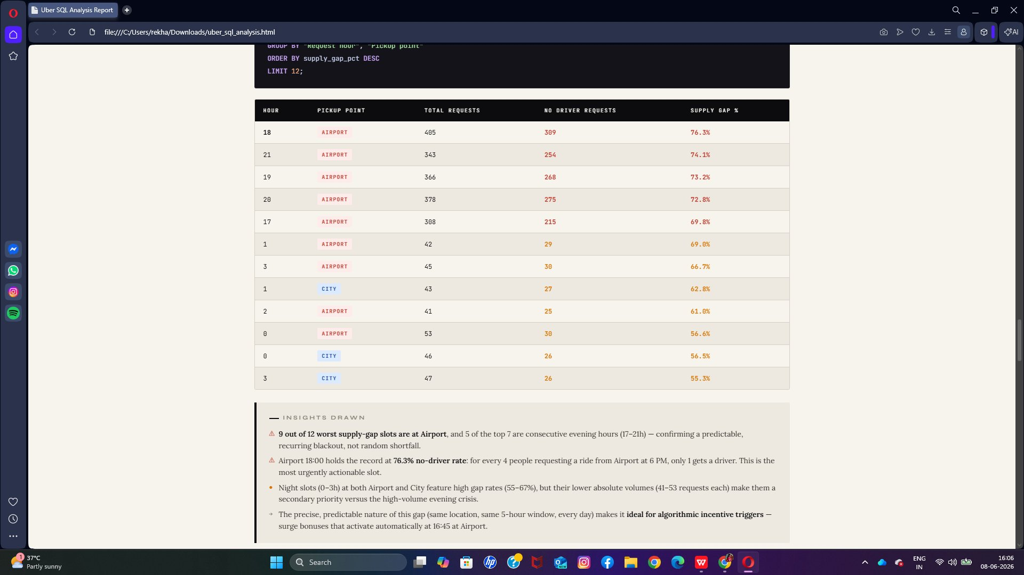
SQL Insight 04
Top 12 Supply Gap Slots — Airport Dominates
Q5 · Top 12 Supply Gap Slots (Hour × Pickup Point)
Insights Drawn
Airport Hour 18 holds the record: 76.3% no-driver rate — only 1 in 4 Airport riders at 6 PM gets a driver
9 of the 12 worst supply-gap slots are at Airport, with 5 consecutive evening hours confirming a recurring daily blackout
This predictability makes it ideal for algorithmic incentive triggers — surge bonuses activating at 16:45 at Airport
📊 Airport Hour 18: 76.3% no-driver rate (worst slot). 9 of top 12 worst slots are Airport. Evening hours 17–21h appear consecutively.

Slide 15
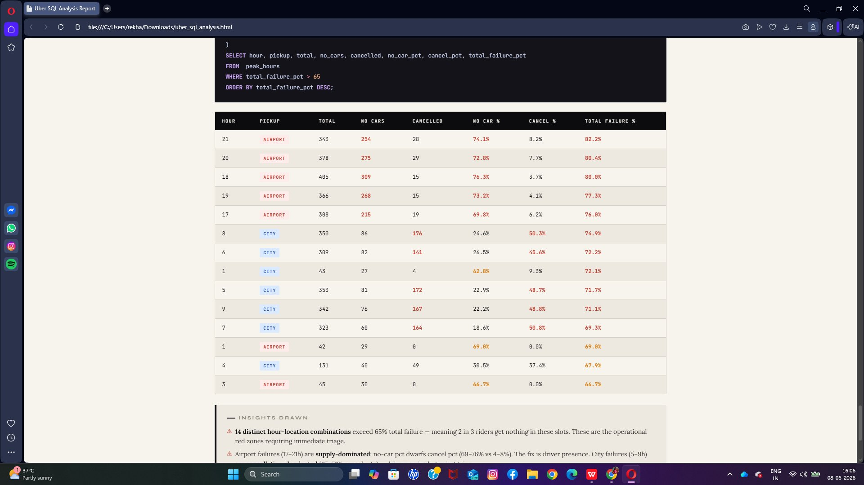
SQL Insight 05
Critical Failure Zones — 82% Failure at Airport 21h
Q8 · Critical Failure Zones — Hour × Pickup With >65% Total Failure Rate
Insights Drawn
Airport Hour 21 has 82.2% total failure — only 1 in 5 late-night Airport requests results in a completed trip
Airport failures (17–21h) are supply-dominated: no-car pct dwarfs cancel pct (69–76% vs 4–8%). Fix = driver presence
City failures (5–9h) are cancellation-dominated (45–51% cancel rate) — drivers arrive but reject short or low-fare trips
📊 14 distinct hour-location combinations exceed 65% total failure. Airport 21h: 82.2% failure (highest). Airport 17–21h: 76–82% failure.

Slide 16
03
Python EDA Analysis
Exploratory data analysis · Statistical patterns · Visual insights

Slide 17
Python EDA — Tasks Implemented
Systematic exploratory analysis using pandas, matplotlib & seaborn
1
Data Loading & Preprocessing
2
Univariate Analysis
Loaded raw Uber dataset, parsed timestamps, extracted hour/date/day features, classified time slots, and handled null values in Driver ID.
Plotted frequency distributions for trip status, pickup point, and request hour to understand baseline patterns and data skewness.
3
Bivariate & Cross-Tab Analysis
4
Heatmap Analysis
Analysed status breakdowns by pickup point and hour; created cross-tabulations for completion vs failure rates across location and time.
Built hour × pickup point heatmaps for no-car rate and completion rate to visually identify the worst-performing time-location combinations.
5
Distribution & Box Plot Analysis
6
Time Series Trend Analysis
Explored trip duration distributions using histograms, KDE plots, and box plots for Airport vs City — comparing spread, outliers, and central tendency.
Plotted daily request volume, completion count, and no-car escalation across the 5-day window to detect improving or deteriorating conditions.

Slide 18
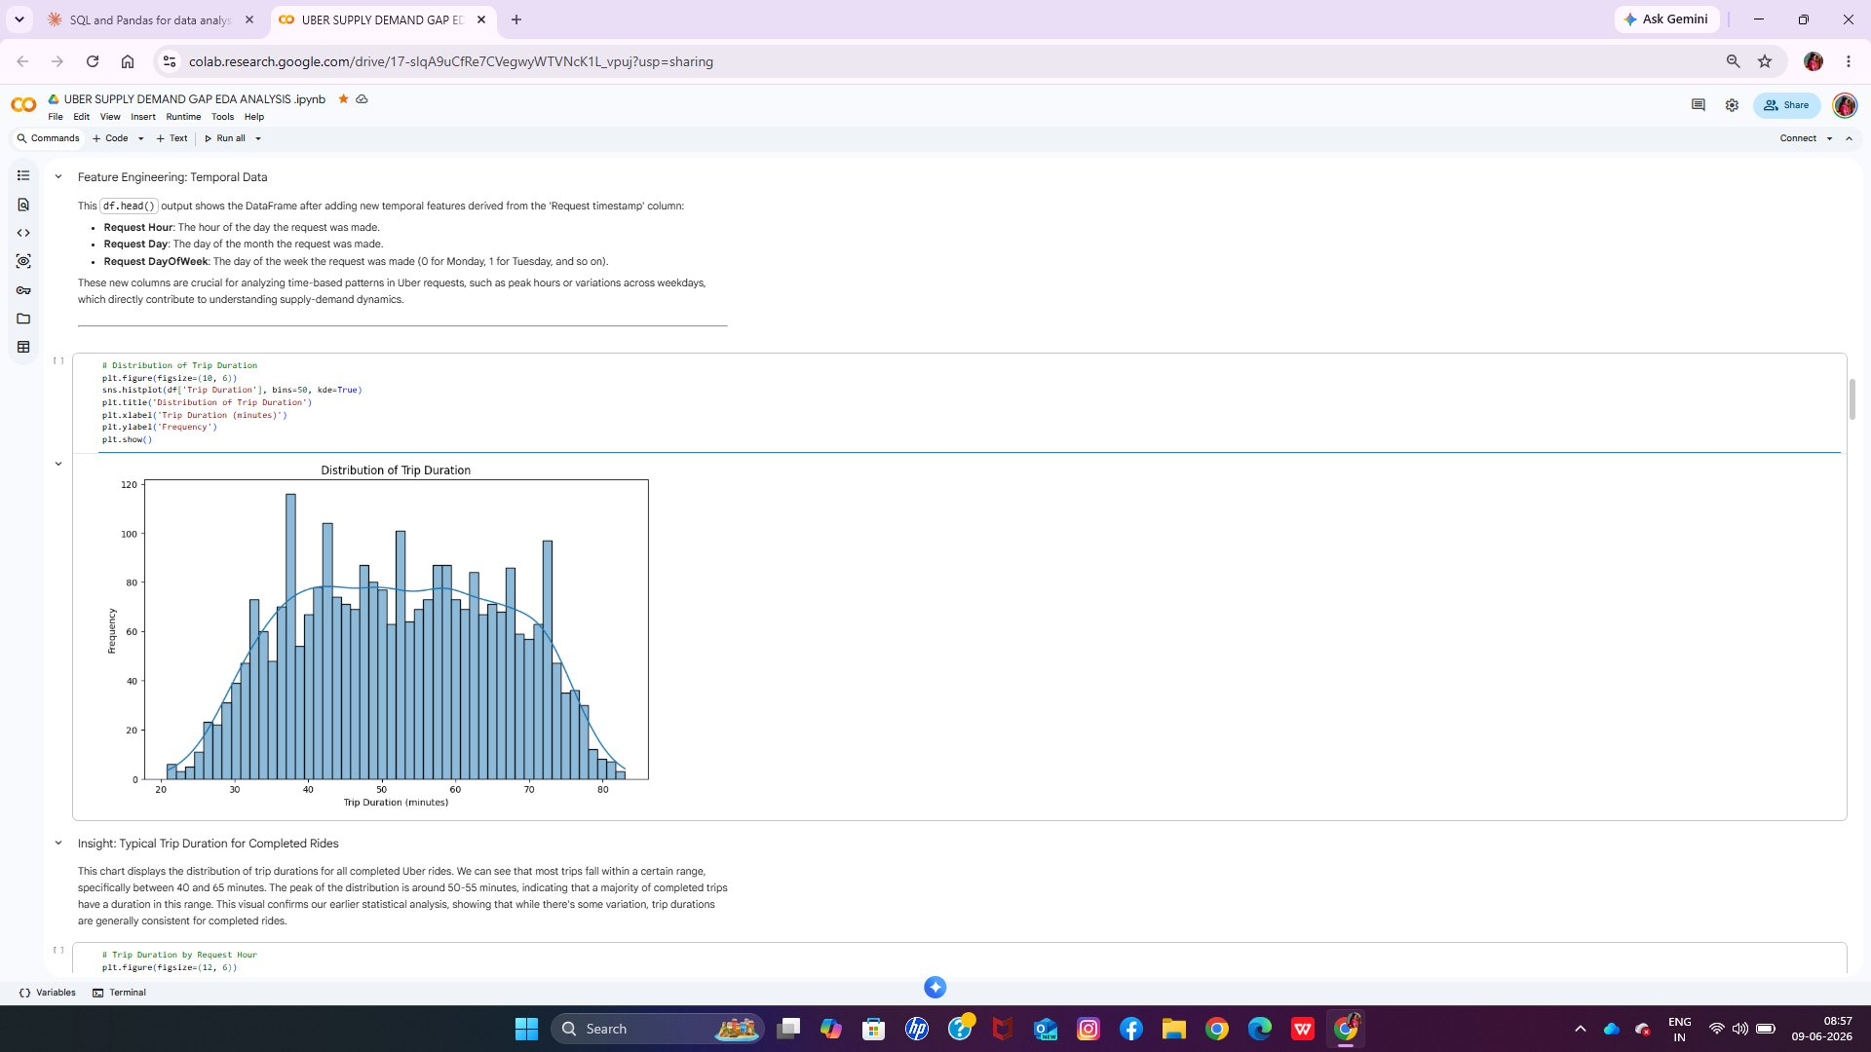
Python EDA Insight 01
Distribution of Trip Duration — Most Rides Take 40–65 Minutes
Histogram + KDE — Distribution of Trip Duration (completed rides only)
Insights Drawn
The majority of completed trips cluster between 40 and 65 minutes — the distribution peaks at 50–55 minutes
A high coefficient of variation (27%) means trip times are unpredictable — riders could experience anything from 21 to 83 minutes
The right skew indicates occasional very long trips pull the average up — median (52 min) is a more reliable planning metric
📊 Mean: 52.41 min · Std Dev: 13.85 min · Min: 20.78 min · Max: 83.0 min · IQR: 41–64 min (2,831 completed trips)

Slide 19
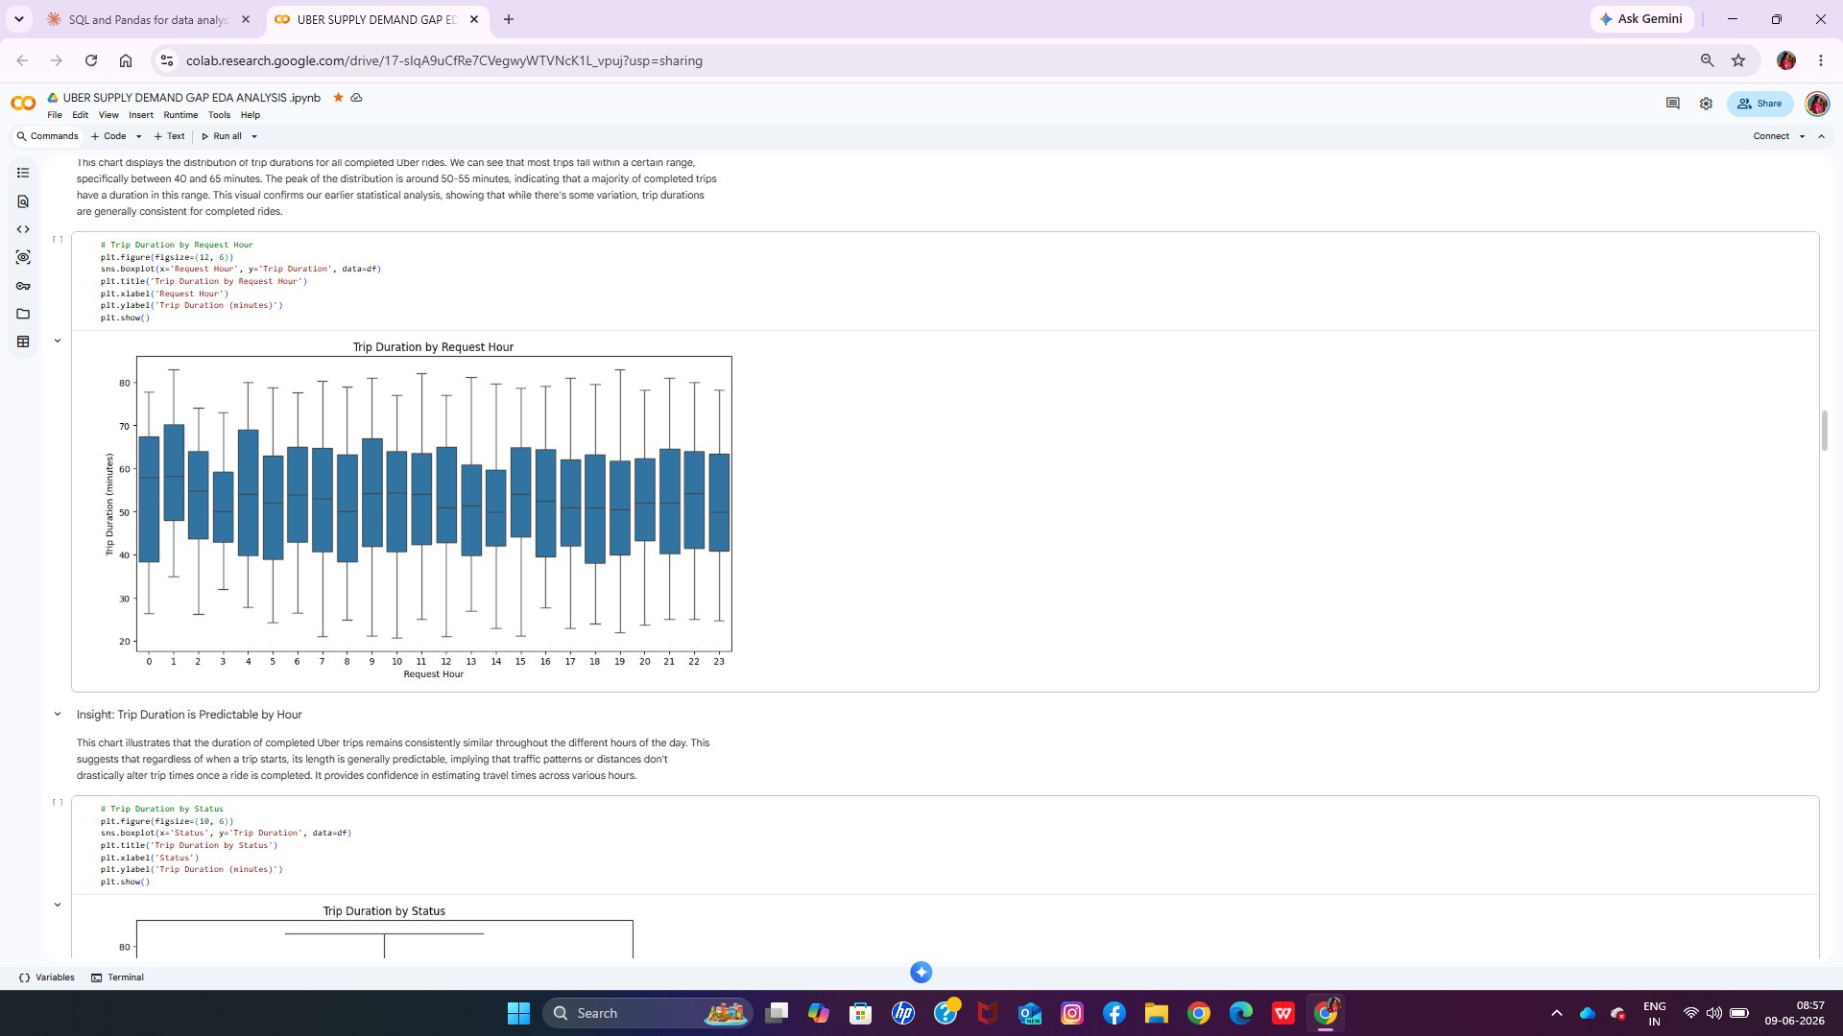
Python EDA Insight 02
Trip Duration by Request Hour — Consistent Across All Hours
Box Plot — Trip Duration (minutes) by Request Hour of Day
Insights Drawn
Trip duration is hour-agnostic — the length of a completed ride is approximately the same whether it starts at 2 AM or 6 PM
This confirms that traffic or time-of-day factors do not significantly alter route length — distances driven are consistent
Since duration is predictable once assigned, all performance gaps are purely a driver availability problem — not an execution problem
📊 Trip durations remain remarkably stable across all 24 hours — median ~52 min and IQR 41–64 min hold constant regardless of time of day.

Slide 20
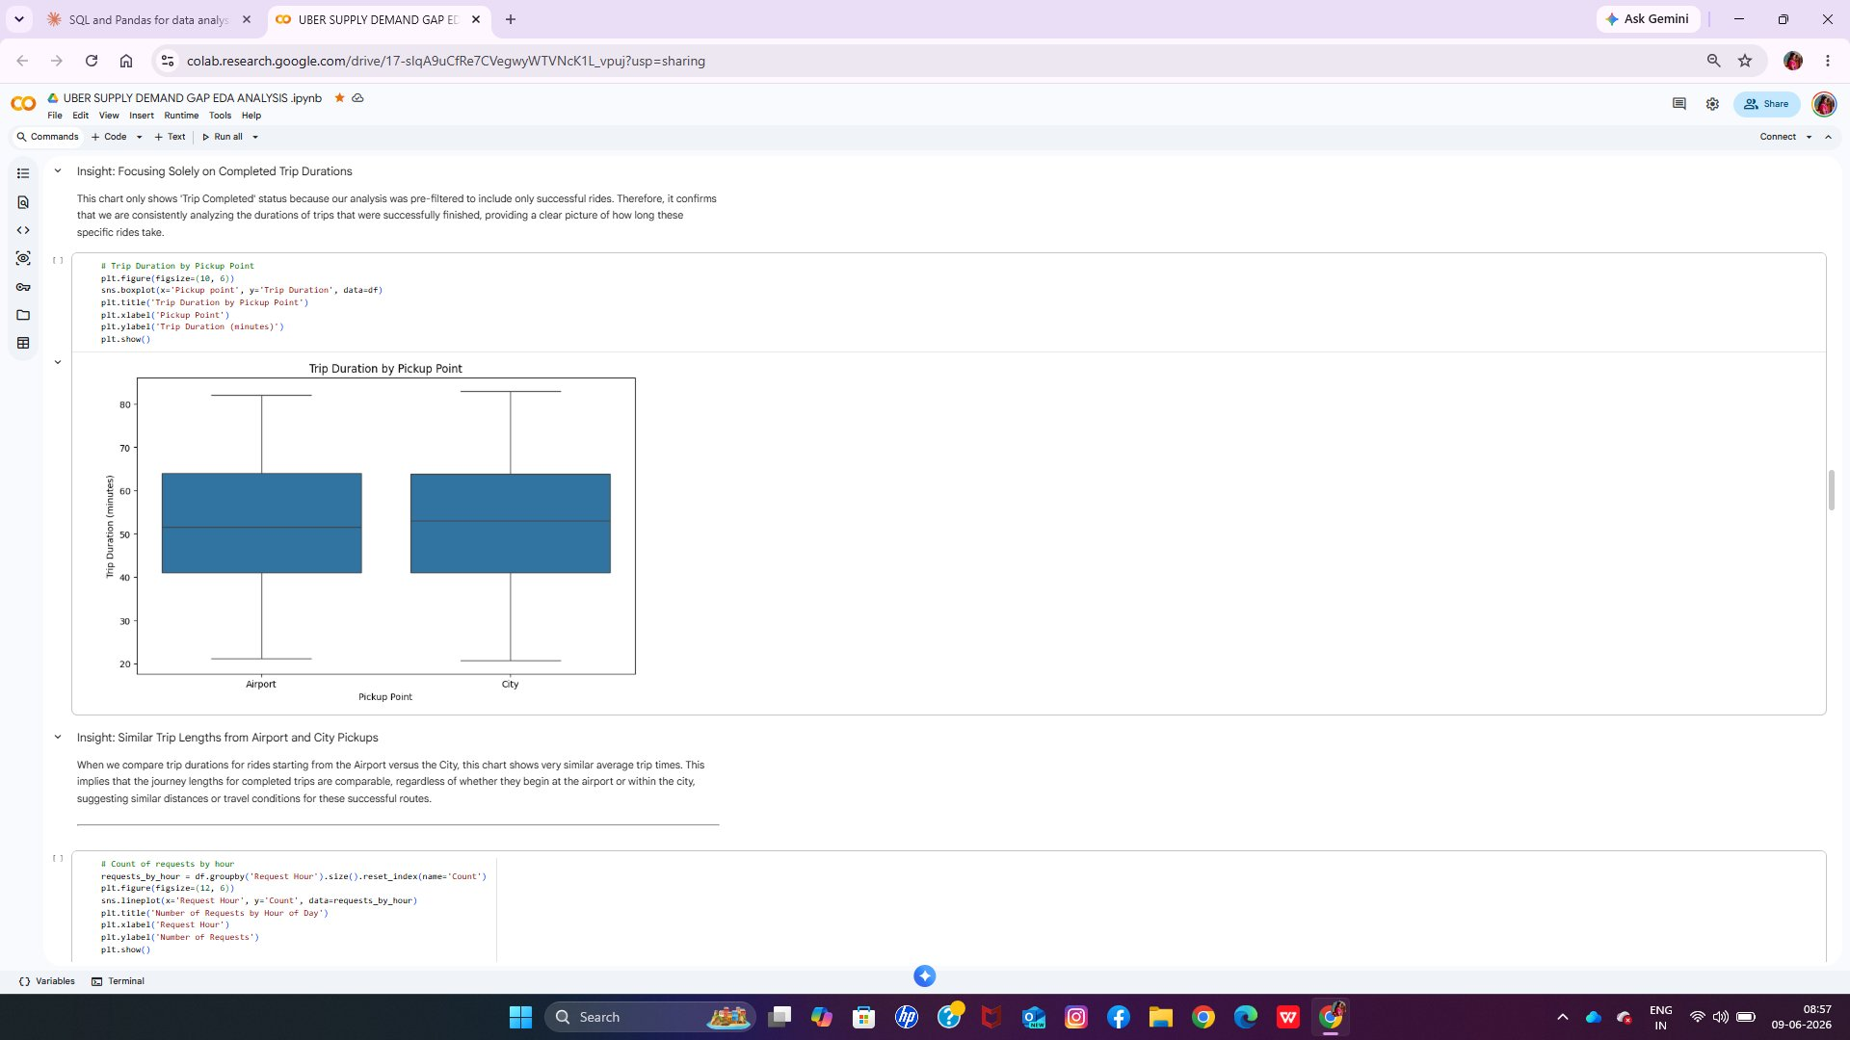
Python EDA Insight 03
Trip Duration by Pickup Point — Airport & City Identical
Box Plot — Trip Duration (minutes) by Pickup Point (Airport vs City)
Insights Drawn
Airport and City completed trips have virtually identical duration profiles — same median, same IQR, same spread
This confirms a shared travel corridor (likely Airport ↔ City), not independent route networks operating independently
Once a driver is assigned anywhere, service quality is equal — all inequalities between locations stem from supply availability, not route difficulty
📊 Airport avg: ~52.4 min · City avg: ~52.6 min · Both IQR: 41–64 min · Both Std Dev: ~13.85 min (2,831 completed trips split: 1,327 Airport, 1,504 City)

Slide 21
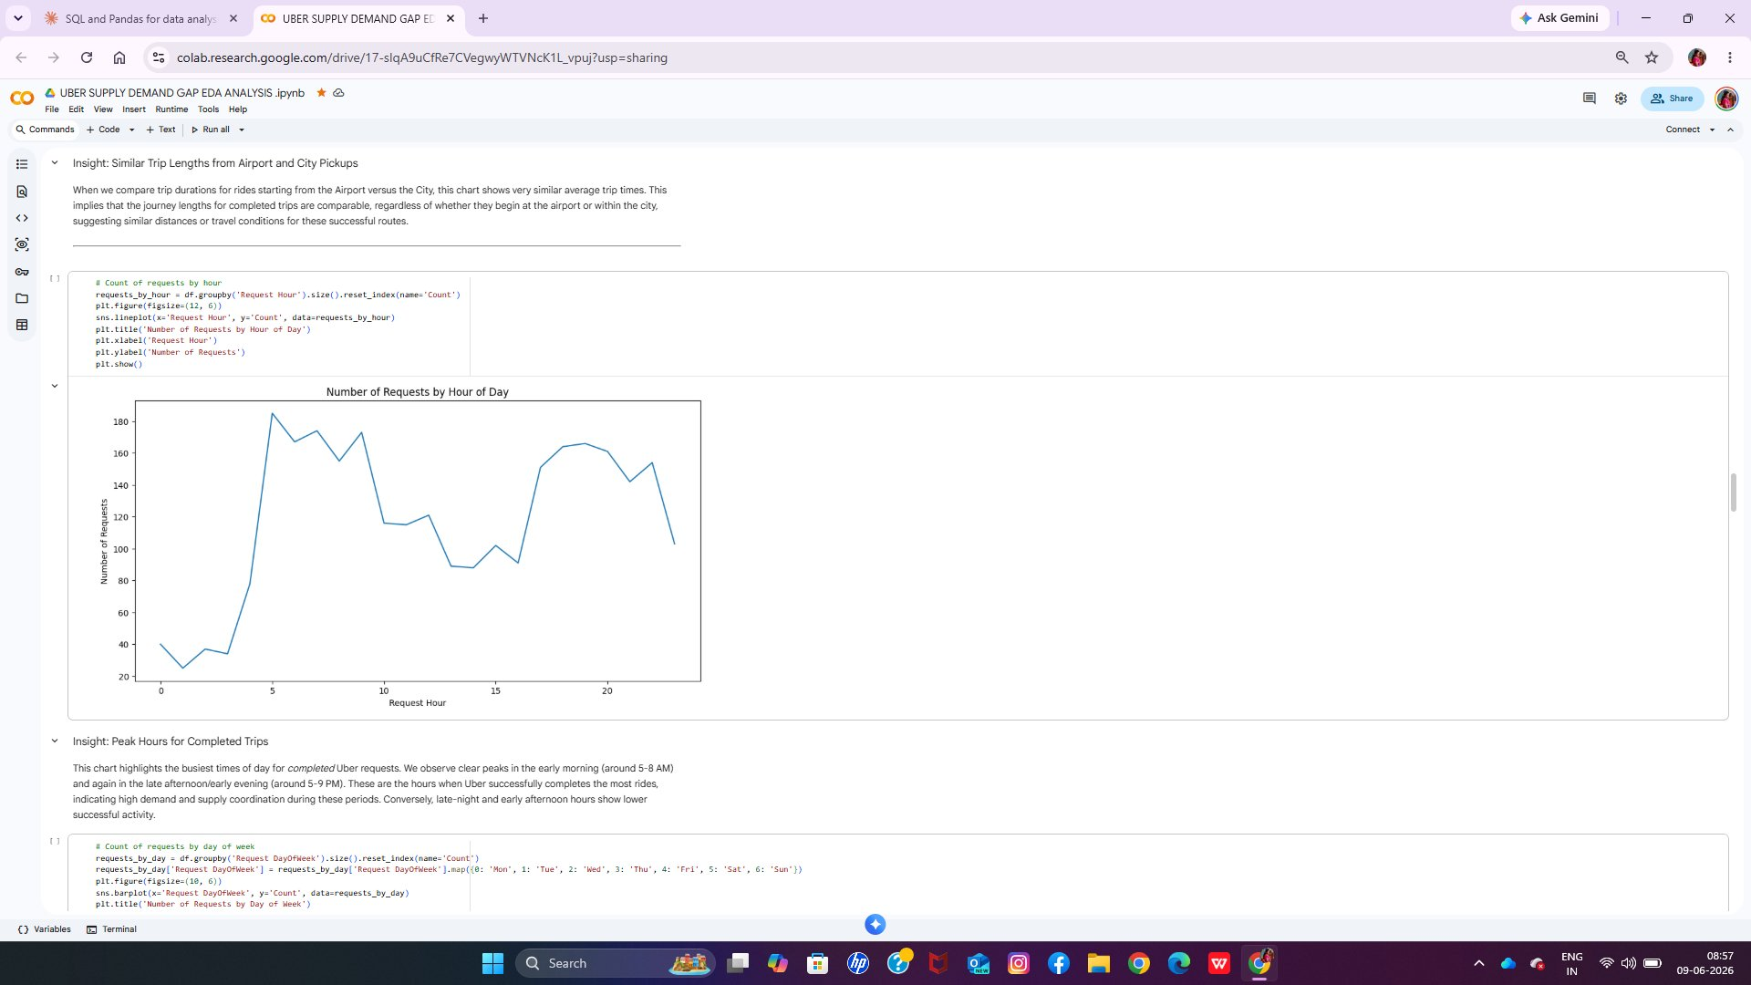
Python EDA Insight 04
Requests by Hour of Day — Twin Peaks at Morning & Evening
Line Chart — Number of Completed Requests by Hour of Day
Insights Drawn
The morning peak (5–8h) represents the highest volume of completed trips — supply and demand are well-aligned here
The evening peak (17–20h) shows high demand but, cross-referenced with SQL data, is where no-car failures are most severe — supply collapses during peak demand
The mid-day trough (10–14h) is the healthiest window — low failure rates and stable supply make it the operational benchmark
📊 Two clear demand peaks: early morning (5–8h) and late afternoon/evening (17–20h). Mid-day (10–14h) shows a pronounced dip in completed trips.

Slide 22
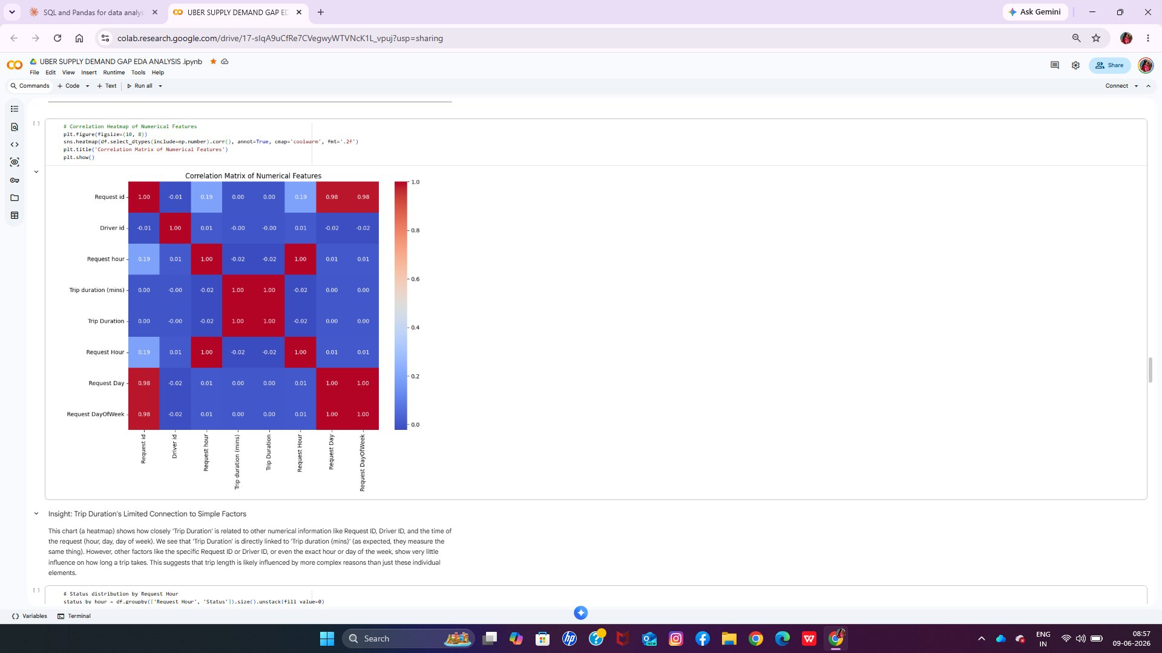
Python EDA Insight 05
Correlation Matrix — Trip Duration Driven by Internal Factors Only
Heatmap — Correlation Matrix of Numerical Features (coolwarm palette)
Insights Drawn
Trip Duration has no meaningful correlation with time of day, driver identity, or day of week — it is driven by route distance, not external scheduling factors
Request Day and DayOfWeek correlate perfectly with each other (1.00) — confirming both are derived from the same timestamp field
The absence of correlations with operational variables means duration cannot be used as a proxy for supply-demand stress — separate metrics are needed to monitor service quality
📊 Trip Duration shows near-zero correlation with Request Hour (0.00), Driver ID (-0.02), Request Day (0.00). Only correlated with Trip Duration (mins) column (1.00 — same field).

Slide 23
Business Solutions
Data-driven interventions to close the 58% failure gap
SUPPLY FIX
CANCELLATION FIX
SYSTEMIC FIX
Airport Evening Supply Surge
City Morning Acceptance Enforcement
Dynamic Driver Allocation Model
▸ Deploy surge incentives at Airport from 16:45–21:00 daily
▸ Flag drivers with >15% cancellation rate and mandate short-trip acceptance
▸ Build ML-based hourly demand forecasting by pickup point
▸ Guarantee minimum driver floor of 30 at Airport during peak hours
▸ Introduce short-trip incentive bonuses during 5–9h City window
▸ Automate driver pre-positioning 30 min before predicted demand peaks
▸ Route City drivers to Airport corridor proactively via dispatch algorithm
▸ Penalise repeated pre-dispatch cancellation with temporary suspension
▸ Use Jul 14-type inflection alerts as an early-warning trigger system
Target: Reduce Airport evening no-car rate from 73% → <35%
Target: Reduce City morning cancellation rate from 45% → <20%
Target: Lift overall completion rate from 42% → 60%+ within 30 days

Slide 24
Conclusion
Key takeaways from the tri-tool analysis
Root Cause Identified:
Airport evening supply shortage (17–21h, 55–76% no-car rate) is the single biggest lever — fixing this alone could add ~700 completed trips daily.
Dual Failure Patterns:
Airport failures are supply-driven; City failures are cancellation-driven. Each requires a distinct intervention — one-size fixes won't work.
Escalating Crisis:
The 5-day trend shows demand growing while supply stagnates. Without intervention, completion rate falls below 35% within weeks.
Morning Gold Standard:
Airport Morning (6–11h) at 84.4% completion proves this operation CAN perform. Study it, then replicate those conditions across all slots.
Data-Ready for Action:
The patterns are predictable, recurring, and location/time-specific — making them ideal targets for algorithmic surge pricing and automated driver dispatch.
Uber Rides Data Analysis · Excel · SQL · Python EDA · Jul 2016 · 6,745 Records

